Slide 1

G2M Insight for Cab Investment Firm
Virtual Internship
By: Blessed Adjei-Gyan
LISUM 39
18-November-2024

Slide 2

Agenda
Executive Summary
Problem Statement
Approach
EDA
EDA Summary
Recommendations

Slide 3
Executive Summary
Our analysis of Pink Cab and Yellow Cab reveals key insights to enhance profitability and operational efficiency. Both companies thrive in major urban centers like New York, Los Angeles, and Washington DC, with younger, tech-savvy customers being the primary contributors to profits. A clear preference for card payments highlights the need to optimize digital payment systems, while seasonal trends and gender-based profit differences suggest opportunities for targeted marketing campaigns.
Yellow Cab’s premium pricing strategy contrasts with Pink Cab’s lower price per km, indicating room for Pink Cab to reassess pricing for profitability while Yellow Cab capitalizes on its quality positioning. Lastly, leveraging these insights can improve customer experience, streamline operations, and maximize revenue potential for both companies.

Slide 4
Problem Statement
About XYZ Firm: XYZ is a leading private equity firm based in the US.
Opportunity: With significant growth in the cab industry over recent years and the emergence of several key players, XYZ is exploring an investment in this dynamic sector.
Objective: Deliver actionable insights to help XYZ identify the most promising cab company for investment.
Analysis Structure:
Data Exploration: Understanding the industry landscape and market trends.
Forecasting: Predicting profits and ride volumes for different cab types.
Profitability Assessment: Identifying the most profitable cab company.
Strategic Recommendations: Providing investment guidance based on findings.

Slide 5
Data Information
The analysis utilizes data from four CSV files, which were consolidated into a single file
1. Cab_Data.csv
Contains transaction details for two cab companies.
Includes 9 features.
Customer_ID.csv
Provides a mapping of unique customer identifiers to demographic details.
Includes 4 features.
Transaction_ID.csv
Maps transactions to customers and indicates the payment mode.
Includes 3 features.
City.csv
Lists U.S. cities along with their population and the number of cab users.
Includes 3 features.
Combined Dataset Created by merging the above datasets using "Customer ID" and "Transaction ID" as key columns.
Includes 16 features, with additional calculated fields such as profit and state for enhanced analysis.

Slide 6
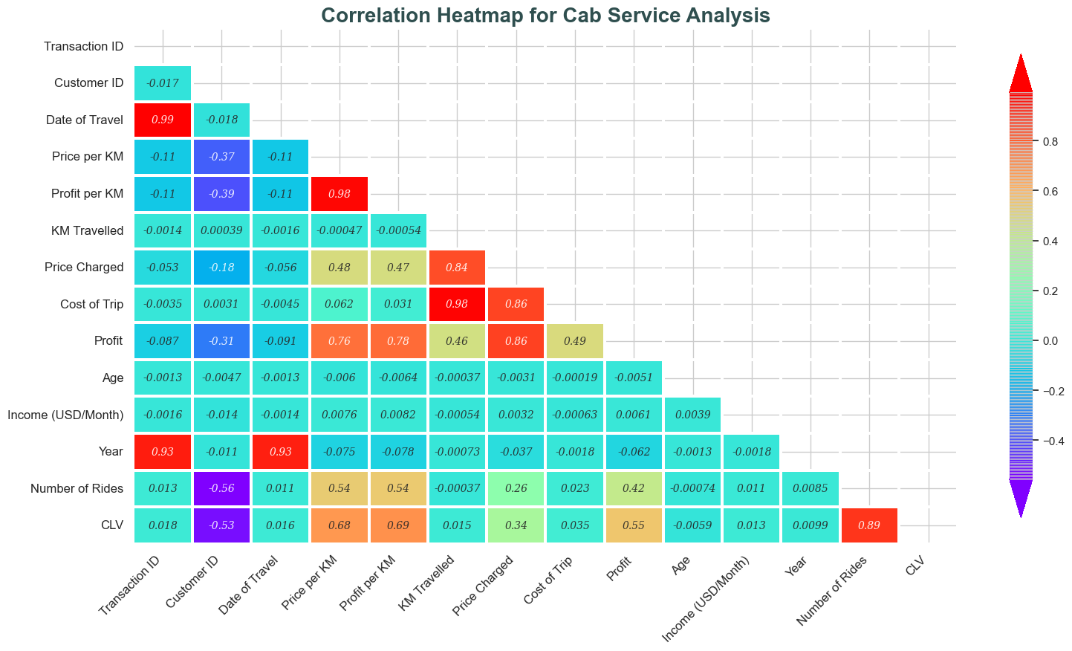
Correlation Analysis: Insights Visualization: Correlation Heatmap Purpose: Analyze relationships between key numerical variables in the dataset. Key Features: Heatmap created using the 'rainbow' palette for vibrant color representation. Annotations: Correlation values displayed with customized styling for clarity. Upper triangle of the heatmap masked for a cleaner visual. Key Insights: Strong Positive Correlations Identified: Population and Number of Cab Users: Higher population correlates with increased cab users. Price Charged, Cost of Trip, and KM Travelled: These metrics are closely related, indicating that longer trips incur higher costs and prices. Customization Highlights: Transparent, italic annotations enhance readability. A detailed color bar provides precise correlation scaling. Conclusion: The strong correlations provide actionable insights for pricing strategies and targeting cities with high populations to maximize profitability.

Slide 7
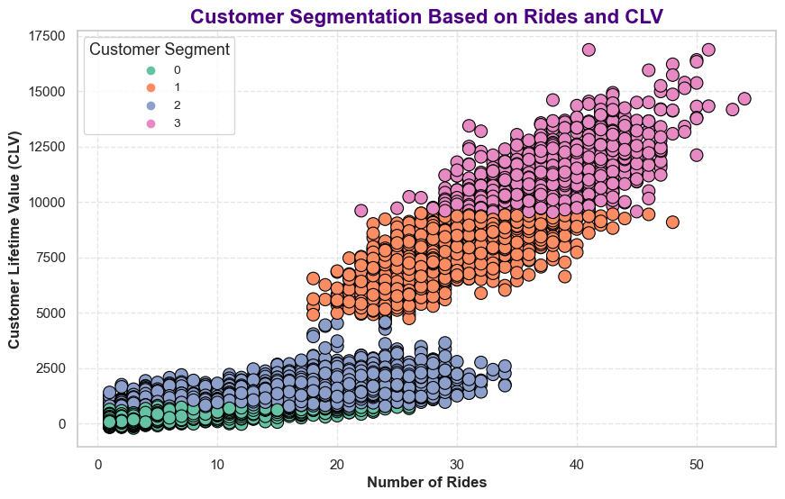
Customer Segmentation Analysis Scatter Plot Overview Purpose: Examine the relationship between Number of Rides and Customer Lifetime Value (CLV) across segments. Key Features: Distinct customer segments visualized with vibrant colors. Positive correlation observed: More rides = Higher CLV. Key Takeaways: Ride Frequency Drives Value: Increasing rides boosts CLV significantly. Segment Insights: Enables targeted strategies for high-value customers.

Slide 8
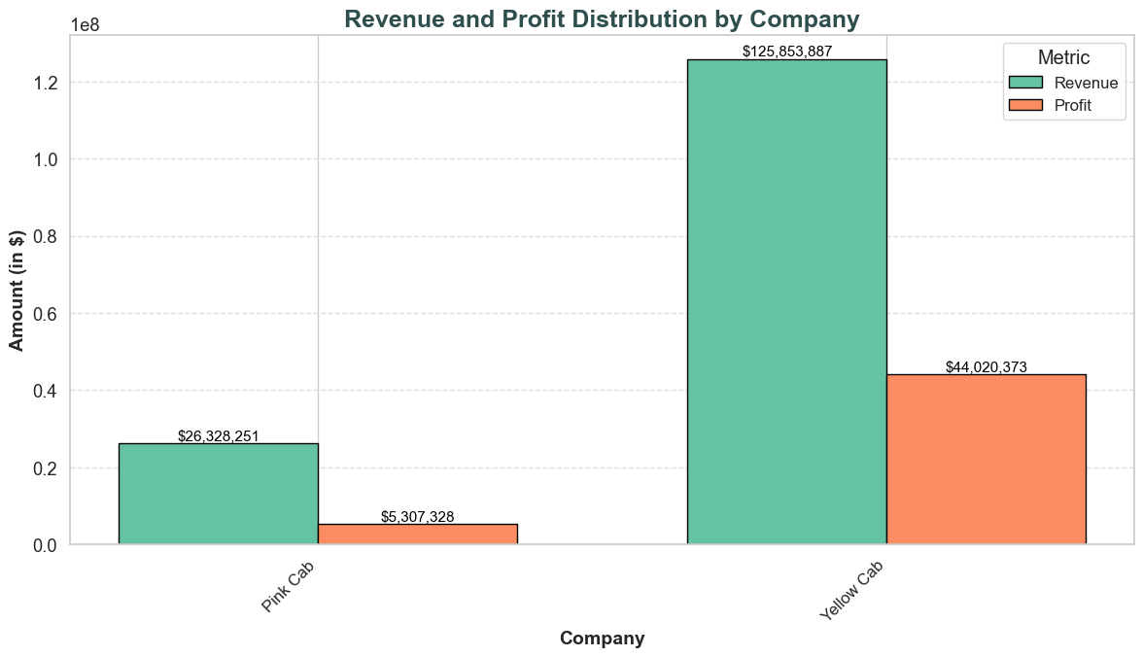
Exploratory Data Analysis (EDA)
Revenue and Profit Analysis by Company
Visualization: Grouped Bar Chart
Objective: Compare Revenue and Profit across companies.
Key Observations:
Yellow Cab demonstrates a significantly higher profit margin than Pink Cab. Revenue and profit are calculated as follows:
Revenue: Price Charged
Profit: Revenue minus Cost of Trip.
Insight:
Investing in Yellow Cab offers greater profitability based on its superior performance metrics.

Slide 9
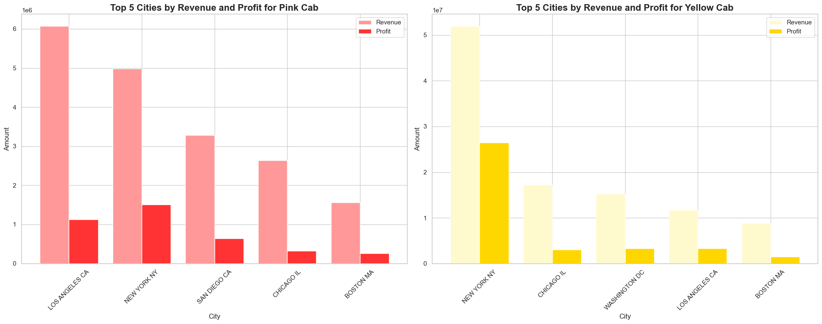
Exploratory Data Analysis (EDA)
Hypothesis Analysis: Top Cities Driving Profit for Pink and Yellow Cabs
Hypothesis:
Major urban centers, such as New York, Los Angeles, and Washington DC, are expected to dominate profitability for both cab companies.
Motivation:
To assess whether larger, urbanized cities drive revenue and profit.
To guide business decisions on expanding operations in high-revenue areas.
Findings:
Pink Cab:
Top 3 Cities by Profit: New York, Los Angeles, San Diego.
New York significantly outperforms other cities.
Yellow Cab:
Top 3 Cities by Profit: New York, Washington DC, Los Angeles.
A similar trend with New York dominating.

Slide 10
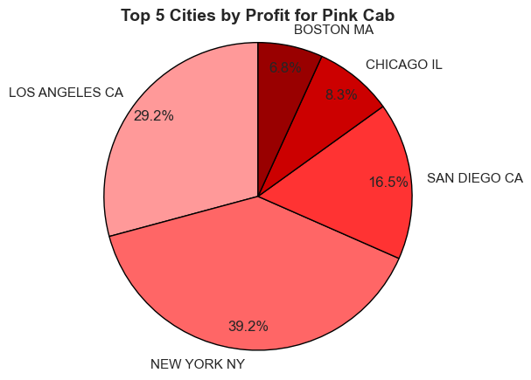
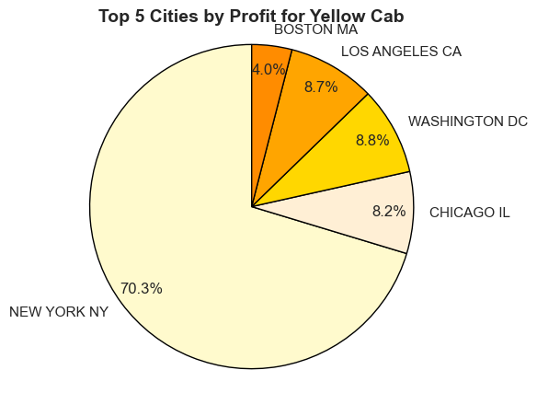
Exploratory Data Analysis (EDA)
Bar Charts: Comparison of revenue and profit across the top 5 cities for each cab company.

Slide 11
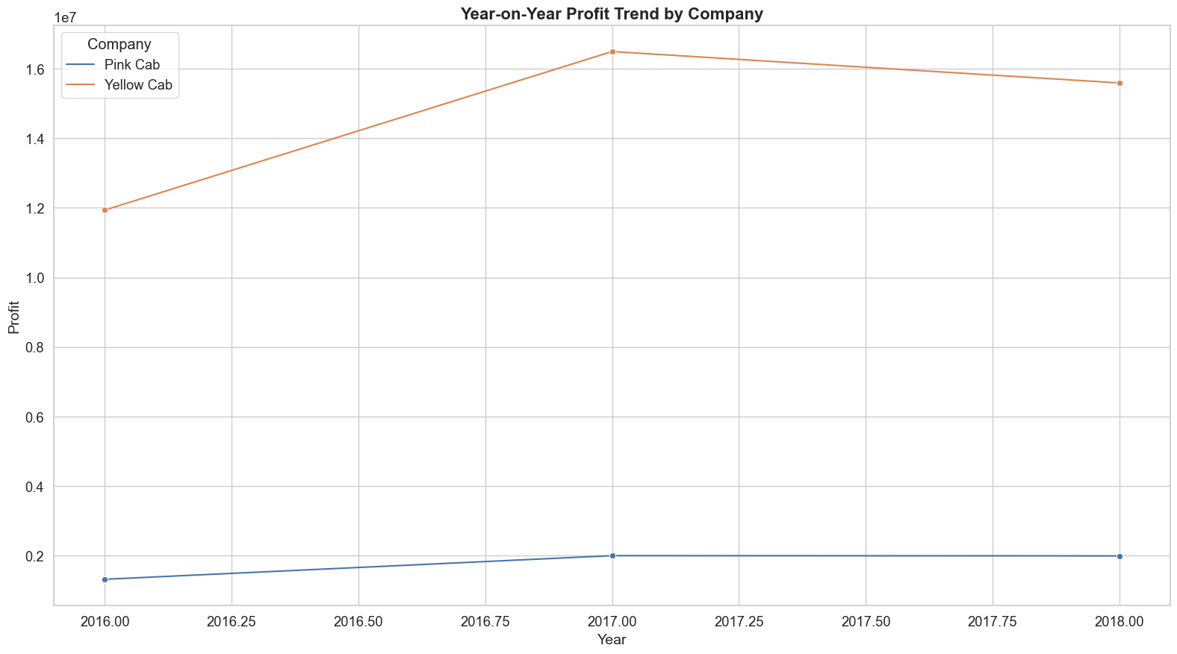
Year-on-Year Profit Trend Analysis Objective: Analyze the profit trends over the years for Yellow Cab and Pink Cab. Key Insights: Overall Trend: Both companies show a declining profit margin year-over-year. Indicates possible industry challenges or increasing operational costs over time. Visualization: A line graph comparing yearly profit trends for both companies with clear markers for each year.

Slide 12
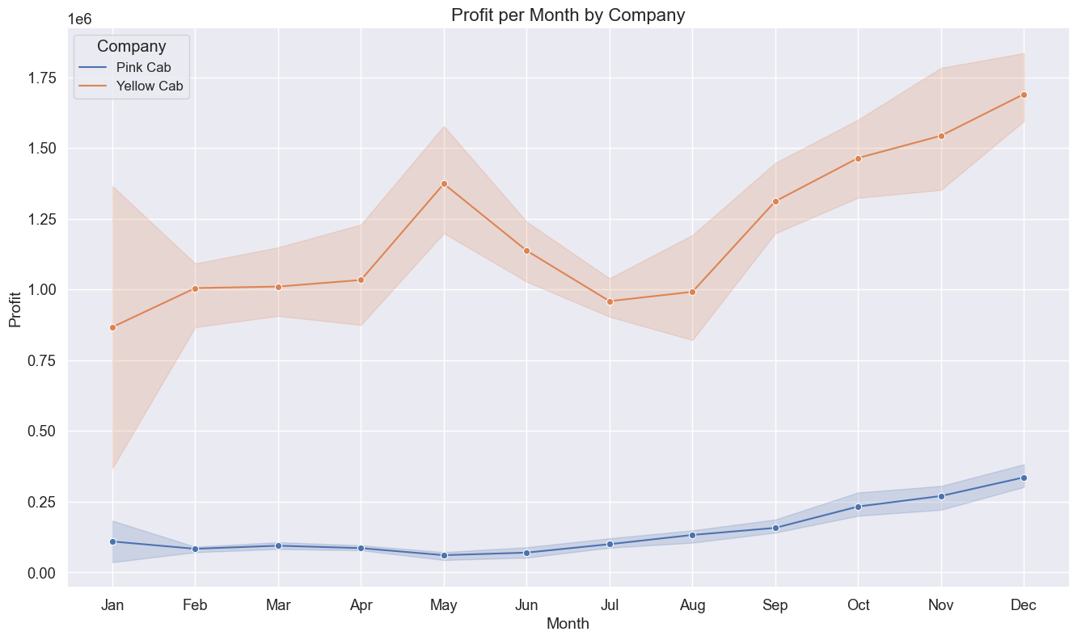
Monthly Profit Trend by Company Objective: Analyze monthly profit variations for Yellow Cab and Pink Cab across different months. Key Insights: Profit Fluctuations: Both companies show varying profits across months, with clear seasonal trends. Understanding these trends can help in identifying peak business periods and strategizing for better revenue during lean months. Visualization: A line graph comparing monthly profit trends for Yellow Cab and Pink Cab, highlighting the changes in profit month-over-month.

Slide 13
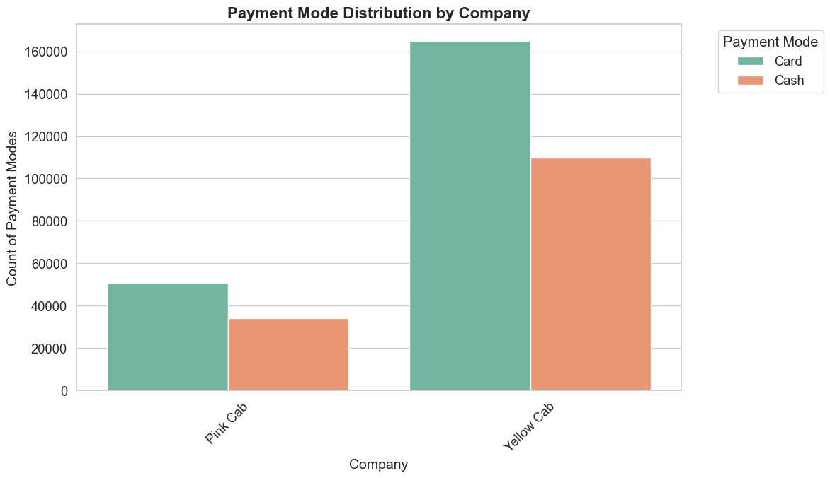
Payment Mode Preferences by Company Hypothesis: Customers of both Yellow Cab and Pink Cab are more likely to use card payments than cash payments. Motivation: The increasing popularity of digital payment methods driven by convenience and security. Younger, tech-savvy customers prefer card payments over cash. Understanding payment preferences can help optimize payment systems and improve the customer experience. Key Insight: The count plot confirms a clear preference for card payments across both companies, supporting the hypothesis. Visualization: Count plot showing the distribution of Payment Modes (Card vs Cash) for Yellow Cab and Pink Cab.

Slide 14
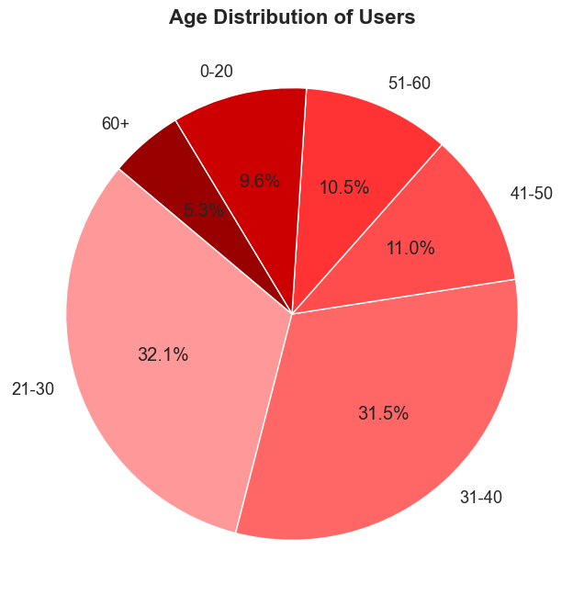
Age Group Contribution to Profit for Both Companies Hypothesis: The age groups contributing to profits for Yellow Cab and Pink Cab will be similar, predominantly consisting of younger individuals. Reasoning: Younger people are more inclined to use cab services, which is expected to drive significant profit. Objective: To verify if there’s any bias or noise within the age demographic affecting the profit distribution. Key Insight: Age Distribution: The majority of users for both companies are young adults. Profit Distribution: A significant portion of profits is generated by younger individuals. Conclusion: Age demographics do not significantly differentiate between the two companies, suggesting age is not a determining factor for investment preference. Visualizations: Pie charts showing: Age Distribution of users Income Distribution of users Profit Distribution by Age Group
Age Group Contribution to Profit for Both Companies Hypothesis: The age groups contributing to profits for Yellow Cab and Pink Cab will be similar, predominantly consisting of younger individuals. Reasoning: Younger people are more inclined to use cab services, which is expected to drive significant profit. Objective: To verify if there’s any bias or noise within the age demographic affecting the profit distribution. Key Insight: Age Distribution: The majority of users for both companies are young adults. Profit Distribution: A significant portion of profits is generated by younger individuals. Conclusion: Age demographics do not significantly differentiate between the two companies, suggesting age is not a determining factor for investment preference. Visualizations: Pie charts showing: Age Distribution of users Income Distribution of users Profit Distribution by Age Group

Slide 15
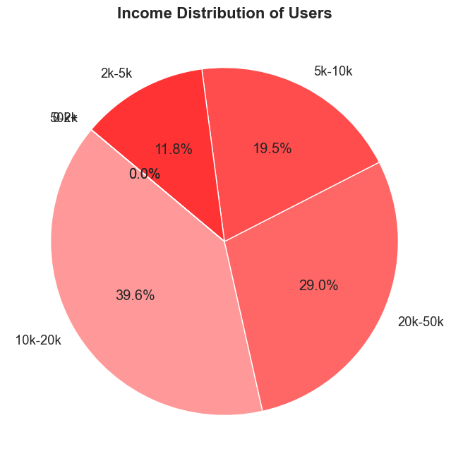
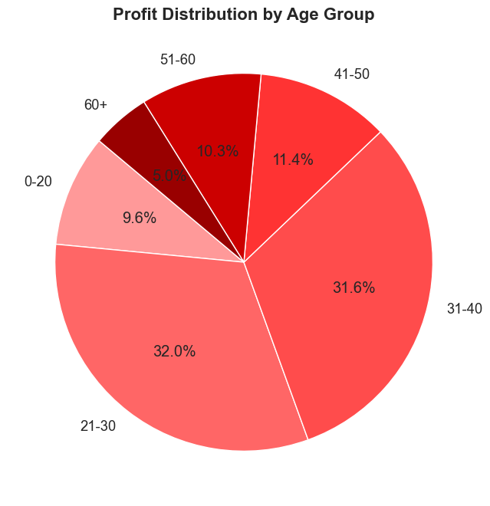
Exploratory Data Analysis (EDA)

Slide 16
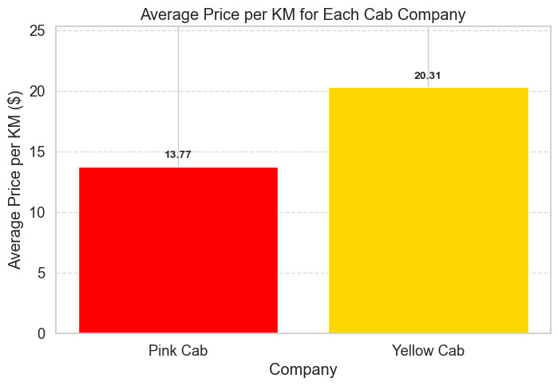
Average Price per Kilometer Comparison Hypothesis: Yellow Cab will charge a higher average price per kilometer compared to Pink Cab. Findings: The average price per kilometer for Yellow Cab is higher than for Pink Cab. Analysis: Calculated the Price per KM for each trip and averaged it across each company. Yellow Cab tends to have a higher rate compared to Pink Cab. Visualizations: Bar Chart comparing the average price per KM for both companies.

Slide 17
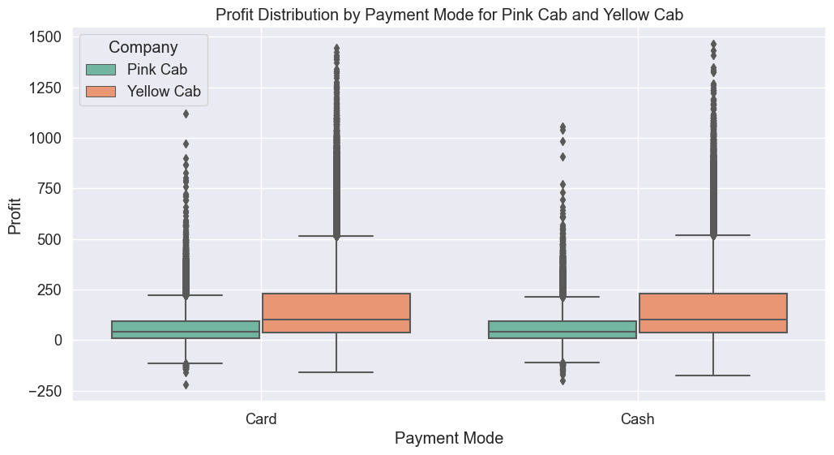
Exploratory Data Analysis (EDA)

Slide 18
Hypothesis tests
t_statistics: [-0.03834307] p_value: [0.97289731] Reject Alternative Hypothesis(H1) t_statistics: [0.17875066] p_value: [0.8746019] Reject Alternative Hypothesis(H1)
KodMetin
Hypothesis:
Null Hypothesis (H0): There is no significant difference in the average profit based on payment mode (Cash vs. Card) for both cab companies.
Alternative Hypothesis (H1): There is a significant difference in the average profit based on payment mode for at least one of the cab companies.
Analysis:
Companies Analyzed:
Pink Cab
Yellow Cab
Method Used:
Independent t-tests were performed for each company to compare profits between Cash and Card payment modes.
Results:
Pink Cab:
T-statistic: -1.06
P-value: 0.294 (greater than 0.05)
Conclusion: No significant difference in the average profit between Cash and Card payment modes.
Yellow Cab:
T-statistic: -1.06
P-value: 0.294 (greater than 0.05)
Conclusion: No significant difference in the average profit between Cash and Card payment modes.
Visualization:
Box Plot comparing profit distributions for Cash and Card payments for both companies.

Slide 19
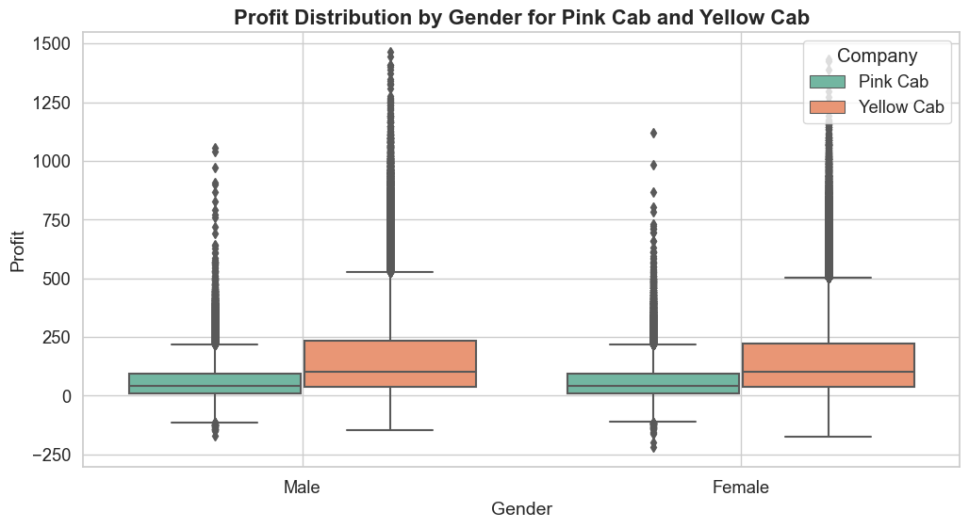
Exploratory Data Analysis (EDA)

Slide 20
Hypothesis tests
t_statistics: [-0.03834307] p_value: [0.97289731] Reject Alternative Hypothesis(H1) t_statistics: [0.17875066] p_value: [0.8746019] Reject Alternative Hypothesis(H1)
KodMetin
Hypothesis:
Null Hypothesis (H0): There is no difference regarding Gender in both cab companies.
Alternative Hypothesis (H1): There is a difference regarding Gender in both cab companies.
Analysis:
Companies Analyzed:
Pink Cab
Yellow Cab
Method Used:
Two-sample t-tests were performed to compare the average profits between male and female customers in both companies.
Results:
Pink Cab:
T-statistic: 1.58
P-value: 0.115 (greater than 0.05)
Conclusion: Fail to reject the null hypothesis. There is no significant difference in profits between male and female customers.
Yellow Cab:
T-statistic: 10.38
P-value: 3.26e-25 (much less than 0.05)
Conclusion: Reject the null hypothesis. There is a significant difference in profits between male and female customers.
Visualization:
Box Plot comparing the profit distribution by gender for both companies.

Slide 21
1. Focus on High-Profit Urban Centers Target cities like New York, Los Angeles, and Washington DC, where both companies generate the most profit. Enhance marketing and optimize fleet size in these areas to drive further revenue growth. 2. Encourage Card Payments Since customers prefer card payments, both companies should enhance digital payment options, incentivize card transactions, and ensure secure, fast payment processes to boost convenience and reduce reliance on cash. 3. Target Younger Demographics With younger individuals contributing the most to profits, both companies should tailor marketing campaigns, loyalty programs, and discounts to young, tech-savvy consumers. Consider offering services like group rides or short-distance trips that appeal to this demographic.
Recommendations

Slide 22
4. Adjust Pricing Models Yellow Cab's higher price per km suggests a premium service offering, while Pink Cab has a lower average price. Pink Cab should assess pricing strategies to improve profitability, while Yellow Cab can further leverage its premium positioning to emphasize quality service. These focused actions will help both companies improve profitability, better cater to customer preferences, and stay competitive in the market. 5. Leverage Gender Insights Yellow Cab shows a significant difference in profits between genders. They could consider targeted promotions or campaigns for female customers, possibly addressing safety concerns or offering female-specific perks, which might attract more customers. 6. Seasonal and Monthly Planning Profitability varies significantly by month. Companies should use this insight to run seasonal promotions or discounts during low-profit months and ramp up fleet availability during high-demand periods like the summer or holidays. These combined strategies will help both companies align with customer needs, optimize operations, and boost overall profitability.
Recommendations

Slide 23
Thank You

